Slide 1
MASTERPIECES OF WESTERN ART Art Humanities W1121 Section 15
Raphael
(Part 1)

Slide 2
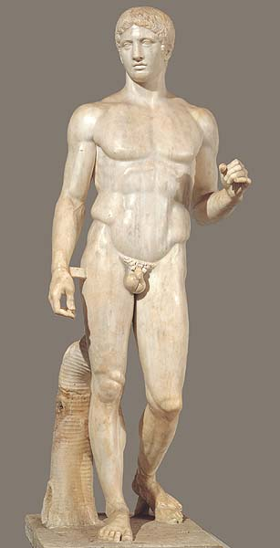
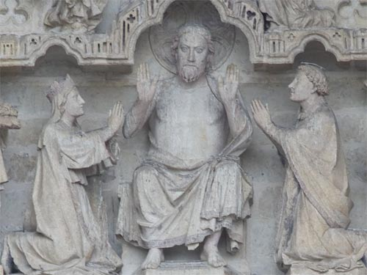
Roman copy of Polycleitos’ Doryphoros
Original c. 440 B.C.
Amiens Cathedral
Christ as Judge
1225-1250

Slide 3
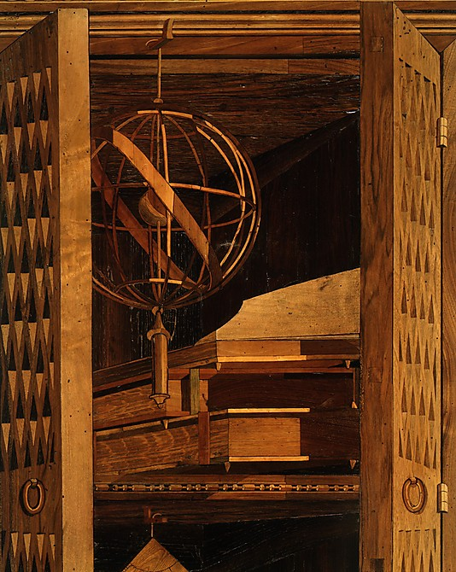
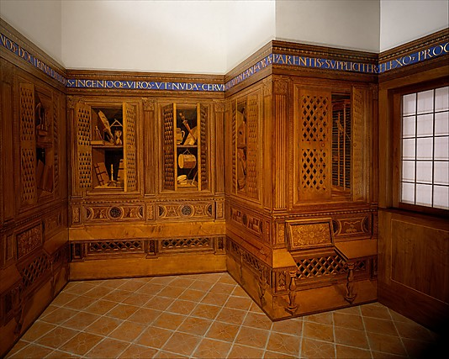
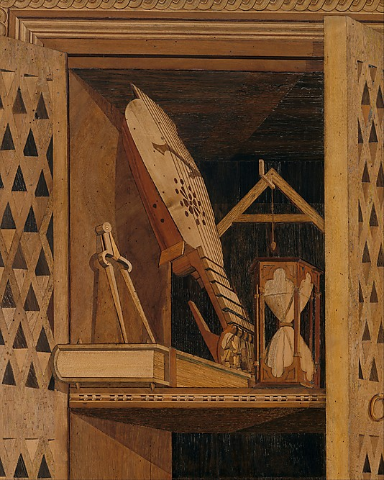
Studiolo from the Ducal Palace in Gubbio
Designed by Francesco di Giorgio Martini, c. 1478-82
Metropolitan Museum, New York

Slide 4
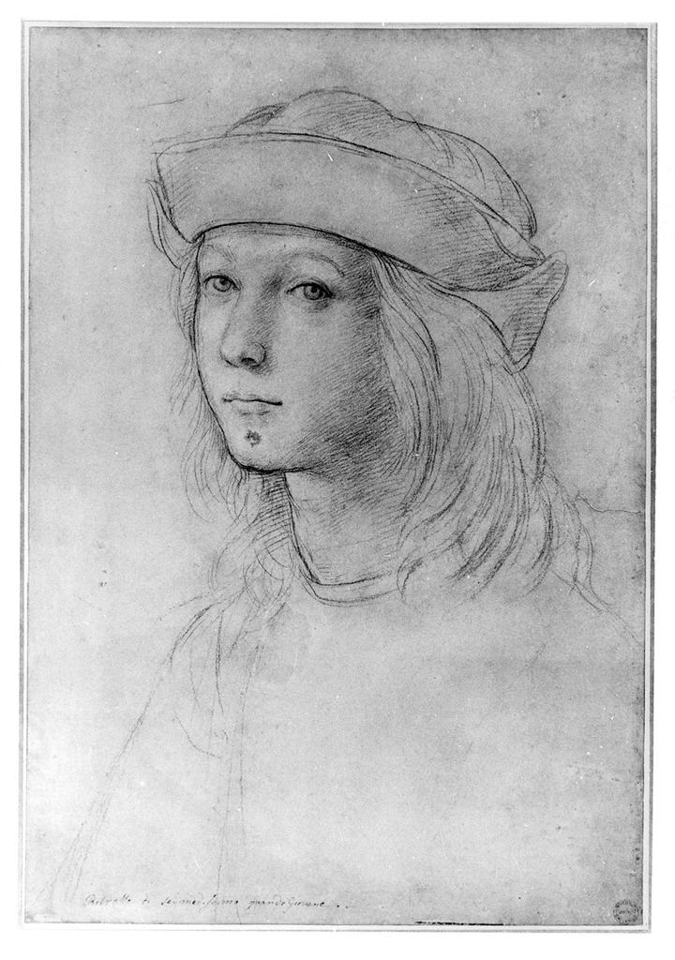
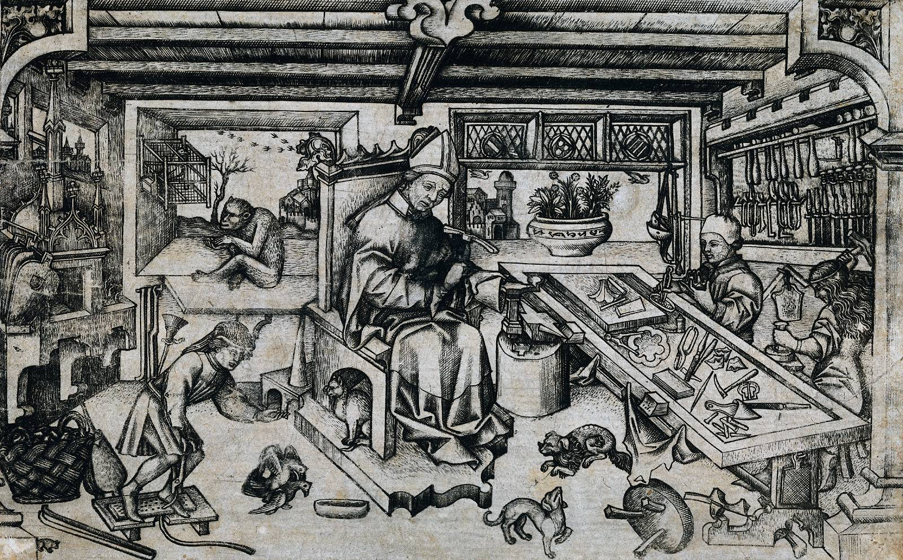
Unknown artist
Saint Eligius in his Studio
c. 1450
Raphael, Self-Portrait, c. 1500

Slide 5
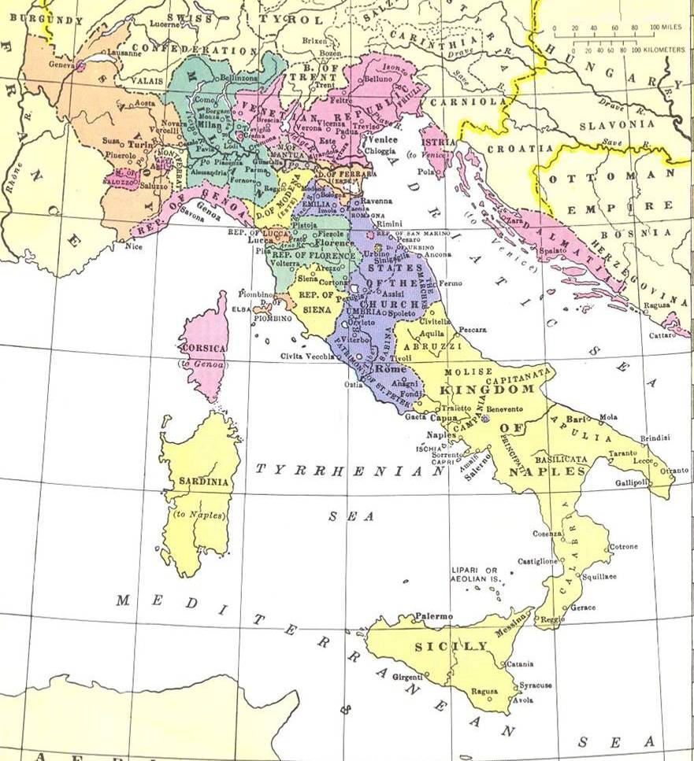
Italy c. 1500

Slide 6
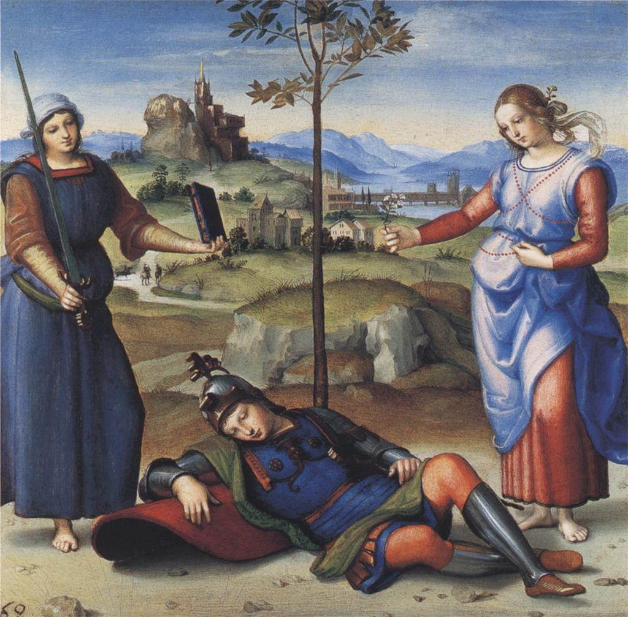
Raphael, Dream of the Knight, 1502-03

Slide 7
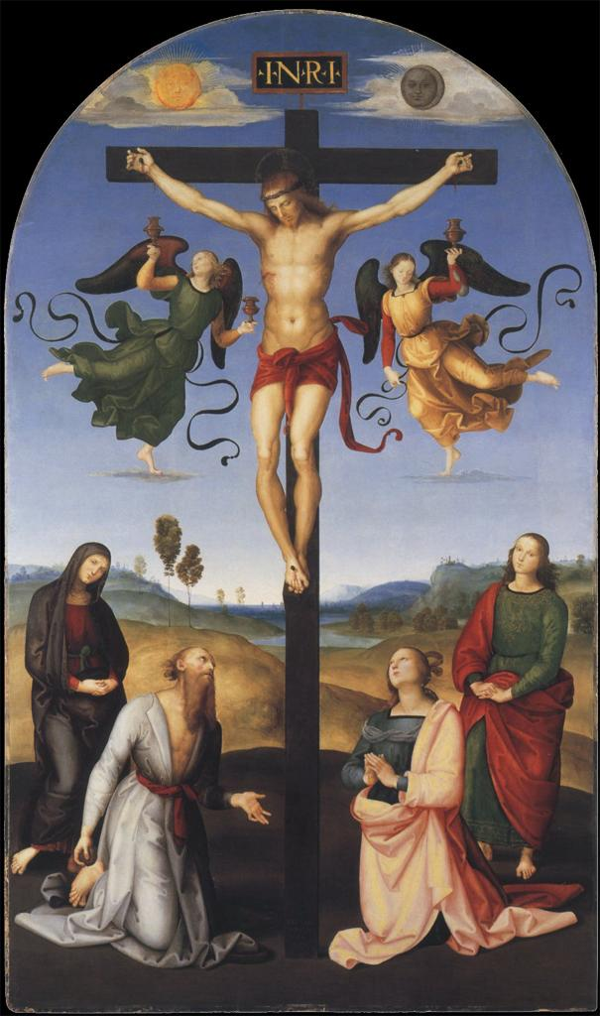
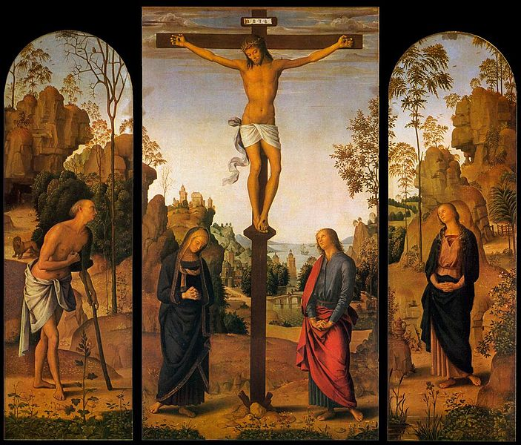
Perugino, Crucifixion, c. 1482-85
Raphael, Crucifixion, c. 1502-03

Slide 8
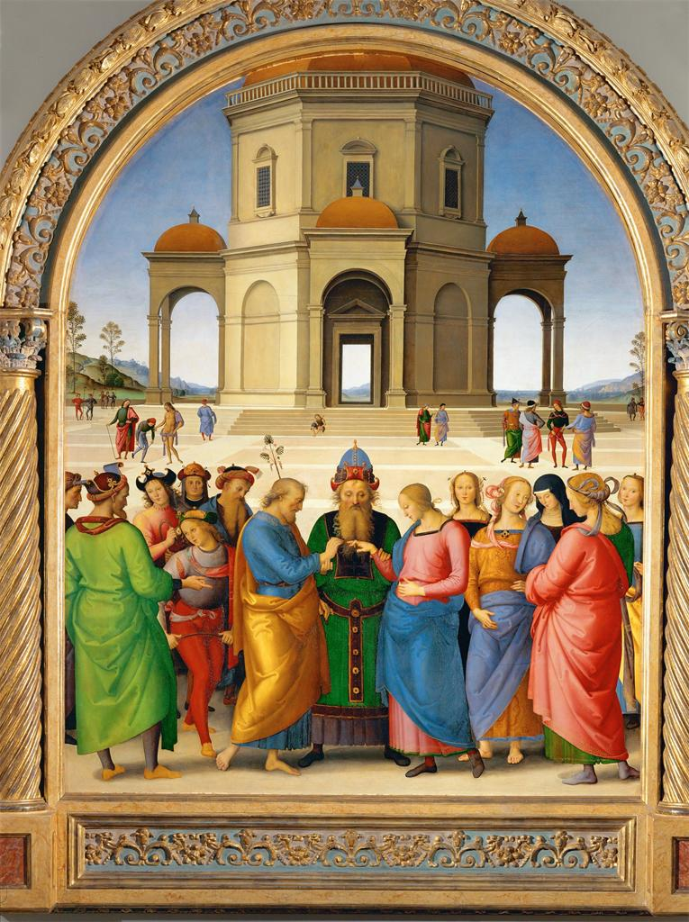
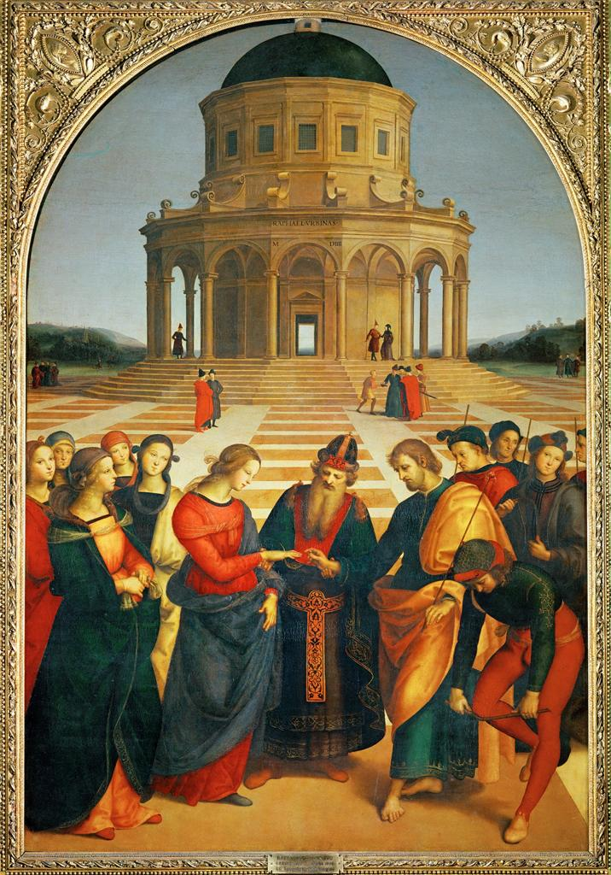
Perugino, Marriage of the Virgin, c. 1503-04
Raphael, Marriage of the Virgin, 1504

Slide 9
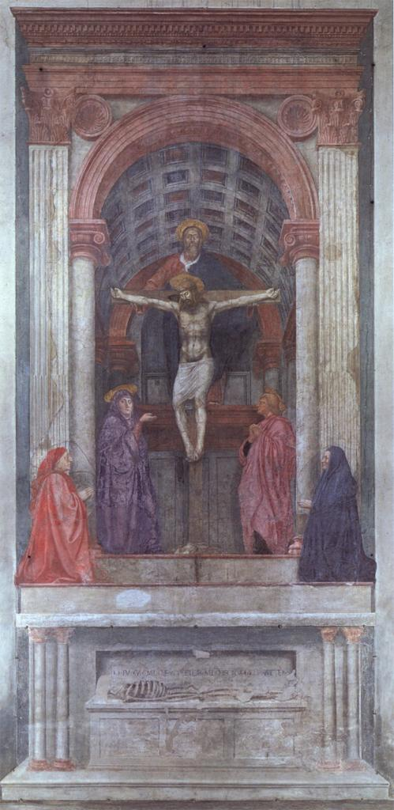
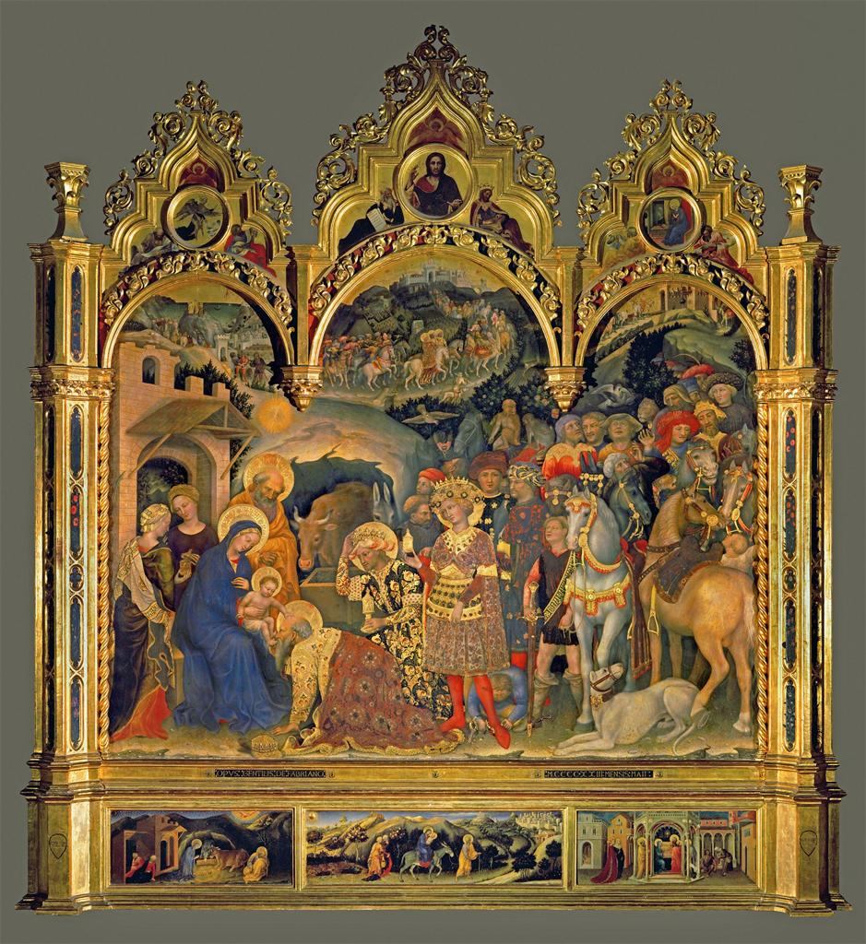
Masaccio,
Trinity with the Virgin, Saint John
the Evangelist and Donors, 1426
Santa Maria Novella, Florence
Gentile da Fabriano,
Adoration of the Magi, 1423

Slide 10
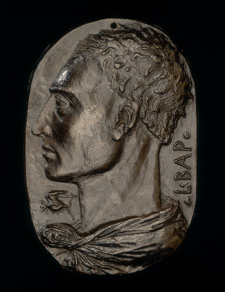
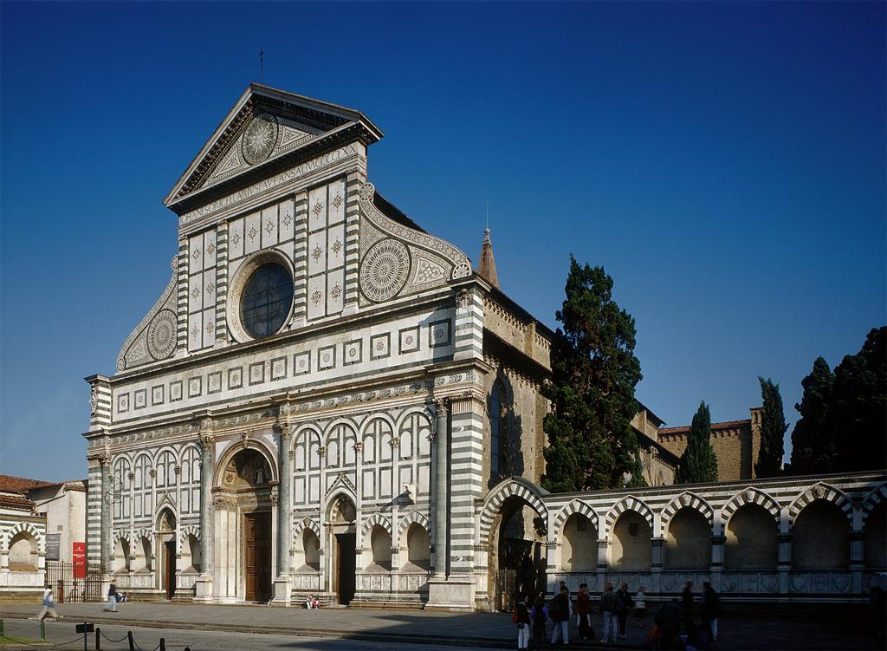
Alberti, Self-Portrait, c. 1435
Bronze
Façade of Santa Maria Novella, Florence
Designed by Alberti in 1458
Constrution completed by 1470

Slide 11
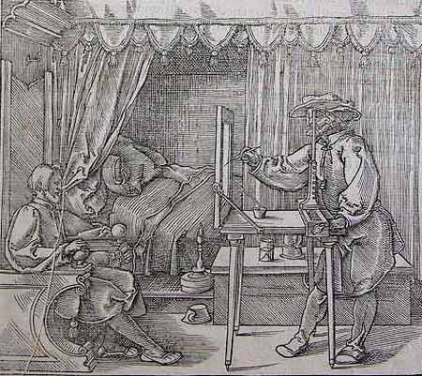
“Perspective is nothing else than the seeing of an object through a sheet of glass,
on the surface of which may be marked all the things that are behind the glass.”
- Leonardo da Vinci”
Albrecht Dürer, Illustration from Unterweysung der Messung, 1525

Slide 12
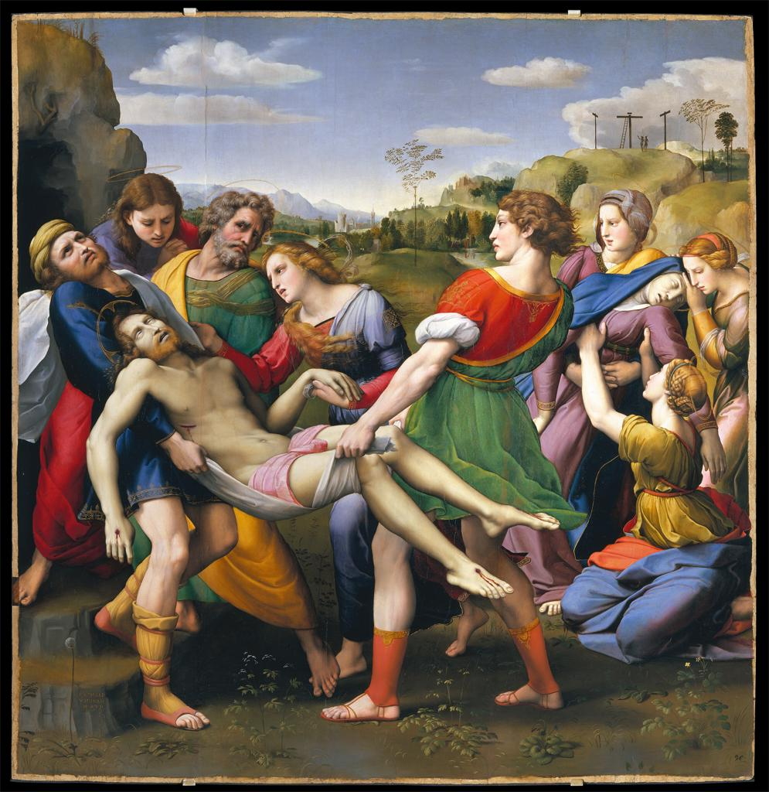
Raphael, Entombment, 1507

Slide 13
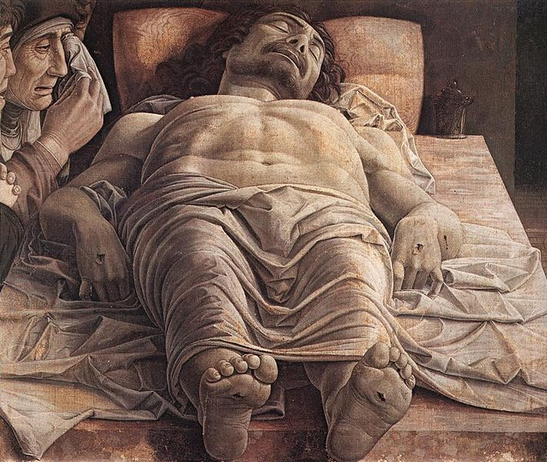
Andrea Mantegna, Dead Christ, c. 1490

Slide 14
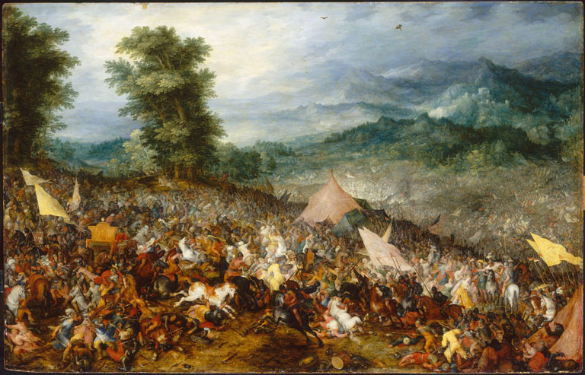
Jan Bruegel the Elder, Battle of Issus, 1602

Slide 15
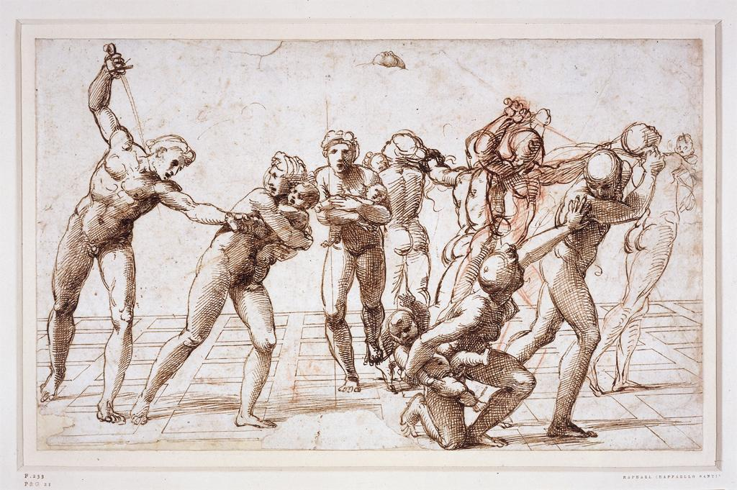
Raphael, Study for The Massacre of the Innocents, c. 1509

Slide 16
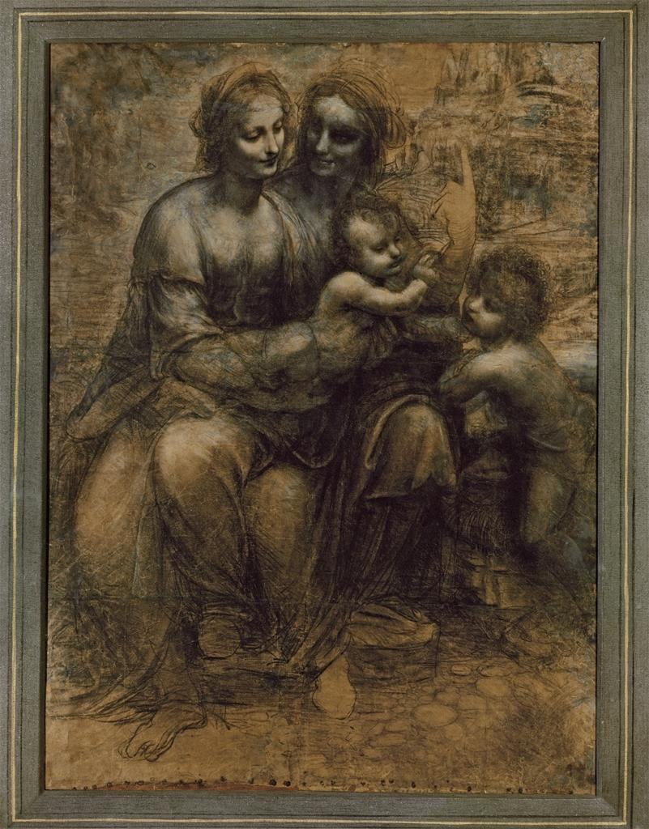
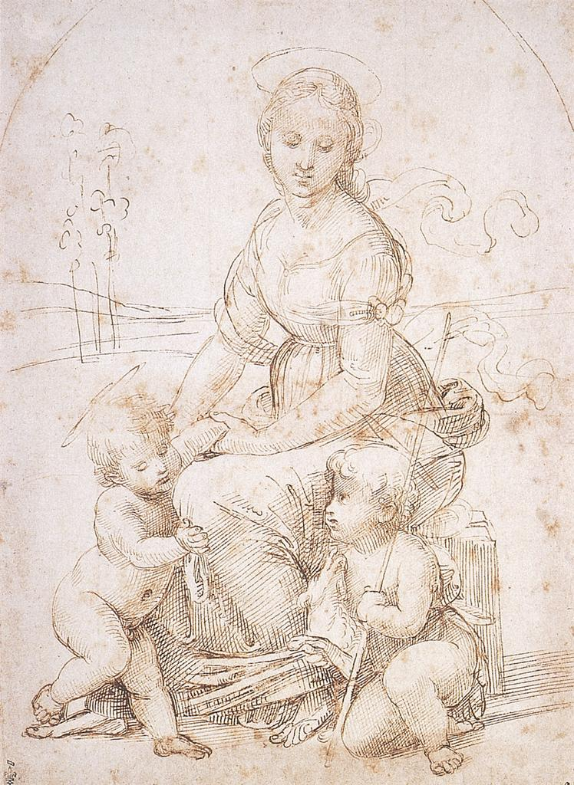
Leonardo da Vinci, Study for Virgin and Child with Saint Anne and John the Baptist, 1499-1500
Raphael, Study for Madonna and Child
with John the Baptist, c. 1507

Slide 17
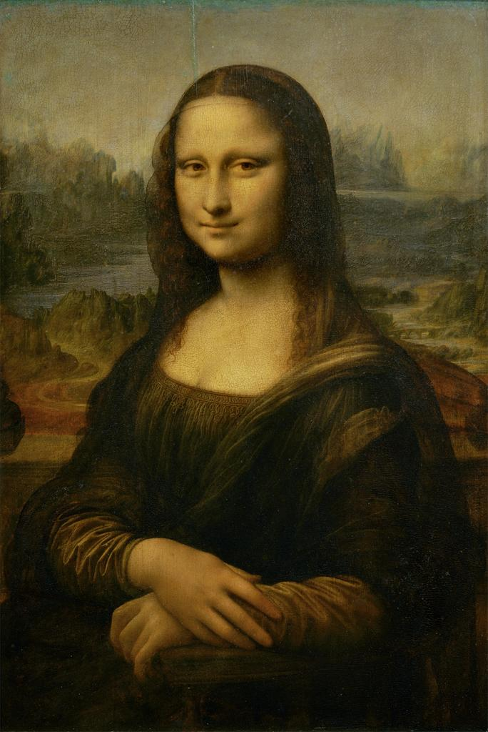
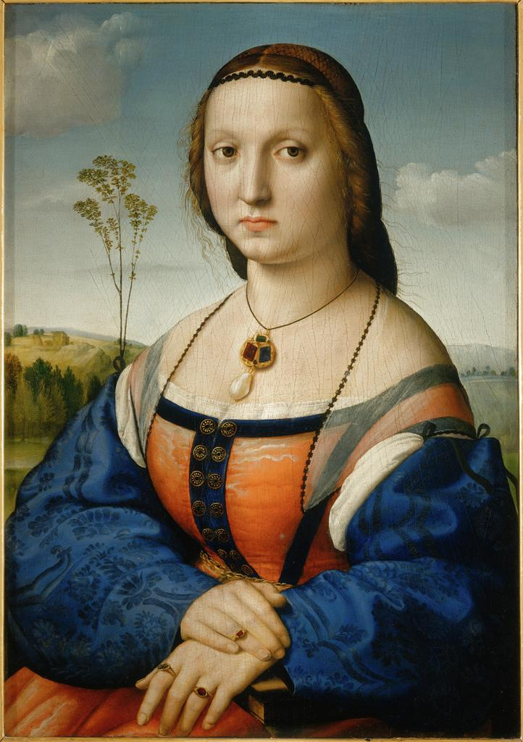
Leonardo da Vinci, Mona Lisa, 1503-06
Raphael, Maddalena Doni, 1505-06

Slide 18
Raphael, Entombment, 1507

Slide 19
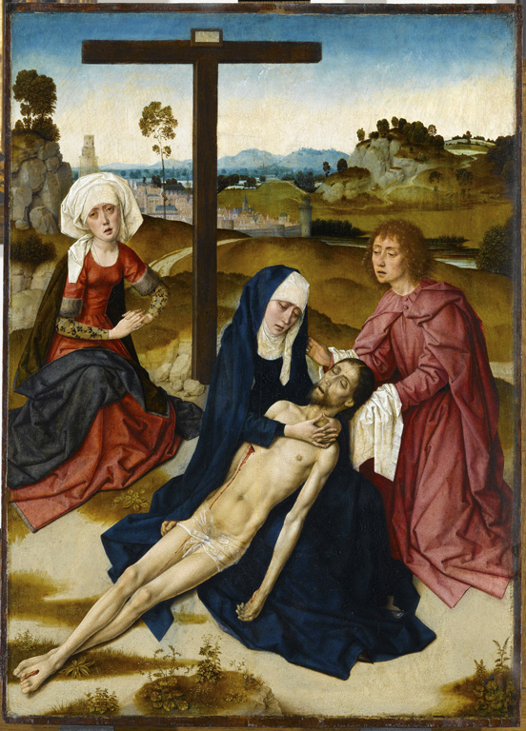
Dierick Bouts, Lamentation, c. 1455-60

Slide 20
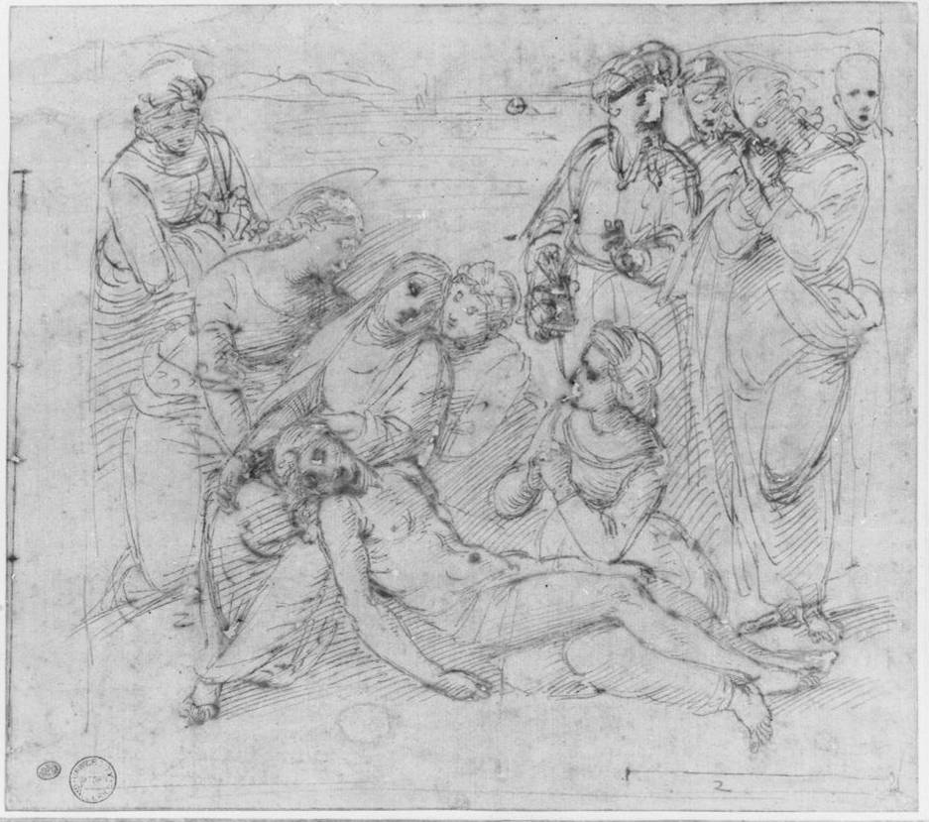
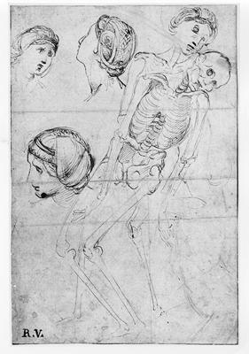
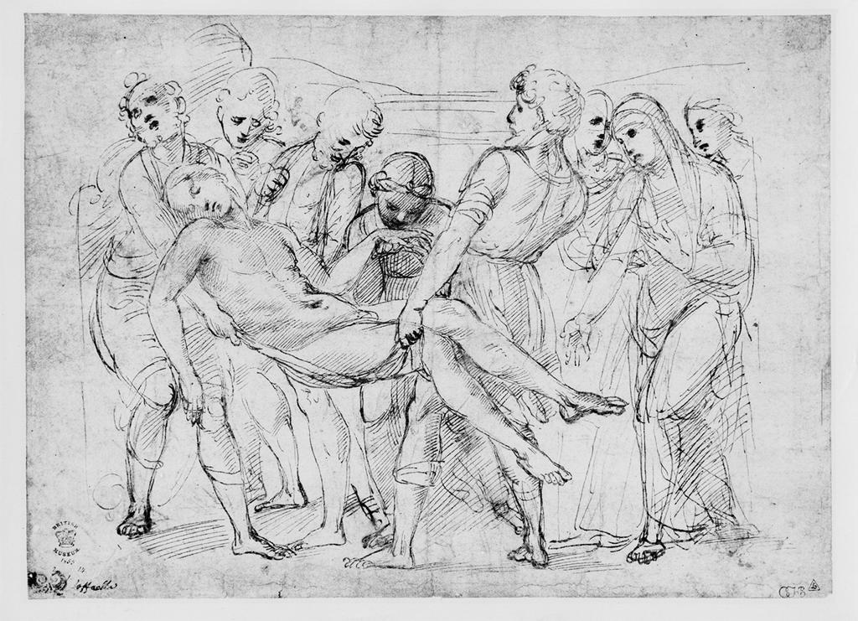
Raphael, Three studies for The Entombment

